Slide 1
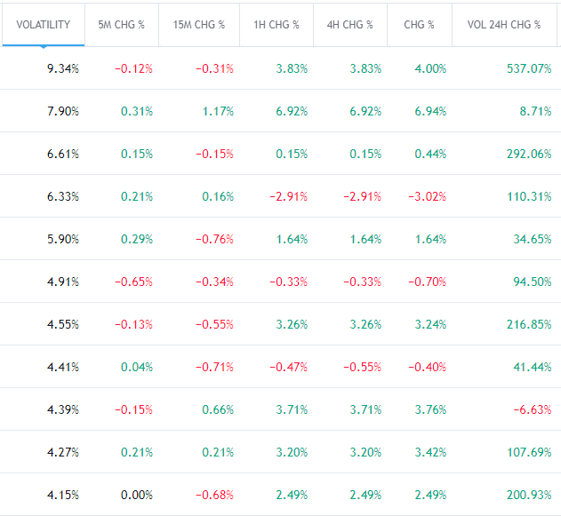
Range &
Volatility

Slide 2
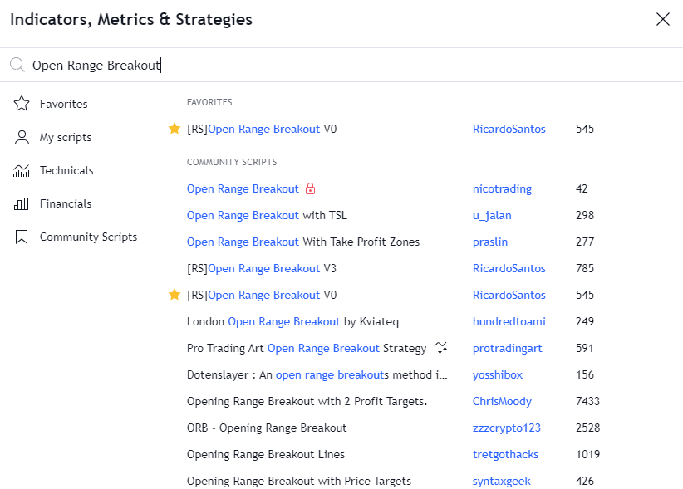
ORB V0

Slide 3
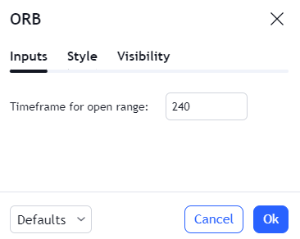
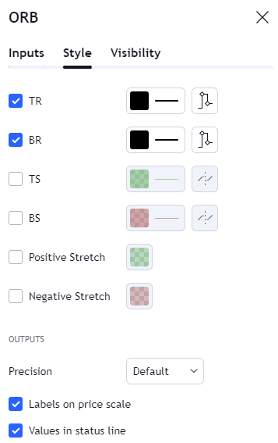
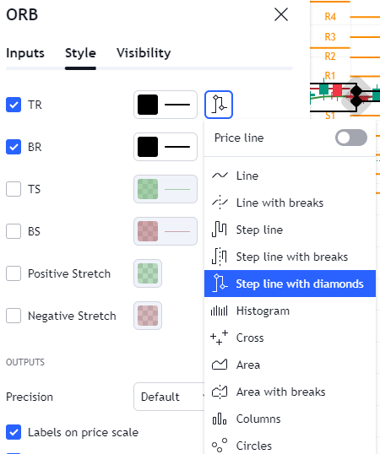
ORB V0 Settings

Slide 4
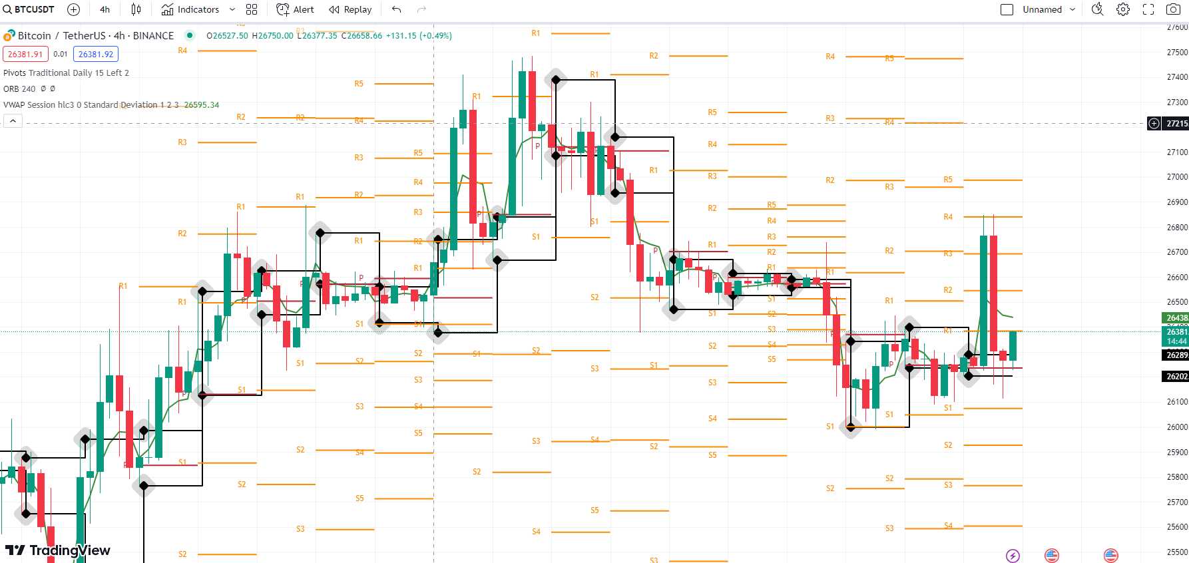
ORB V0 + Pivot Points + VWAP (4h)

Slide 5
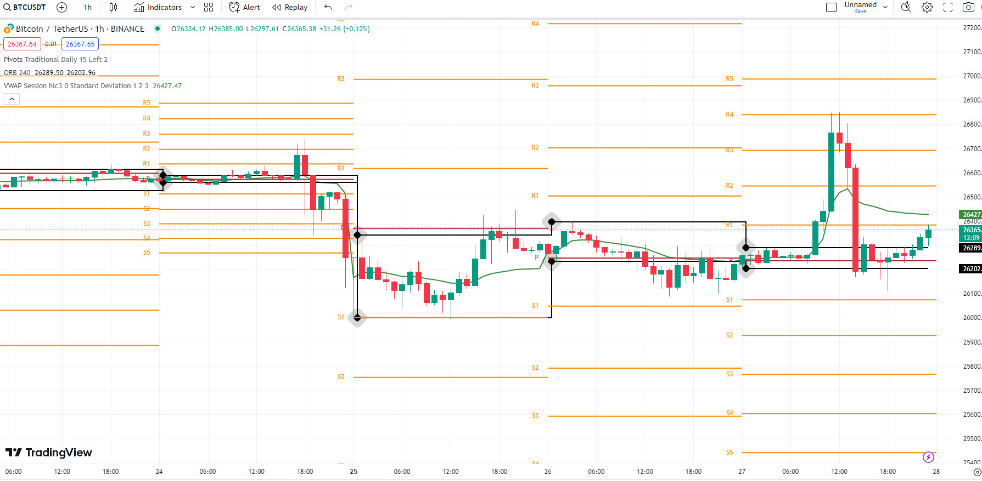
ORB V0 + PP + VWAP (1h)

Slide 6
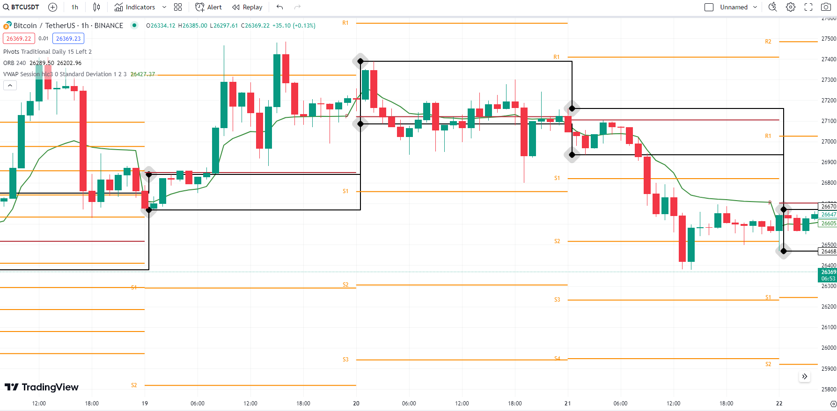
ORB V0 + PP + VWAP (1h)

Slide 7
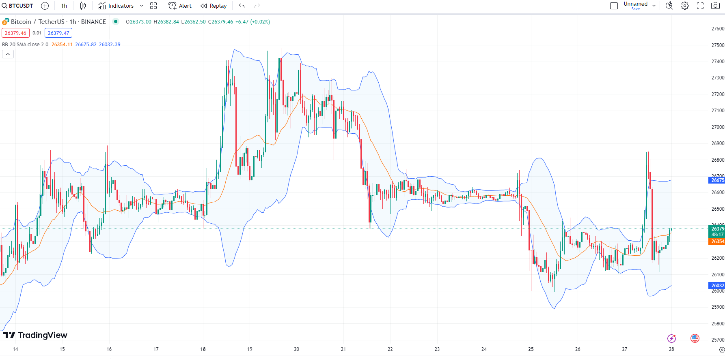
Bollinger Bands

Slide 8
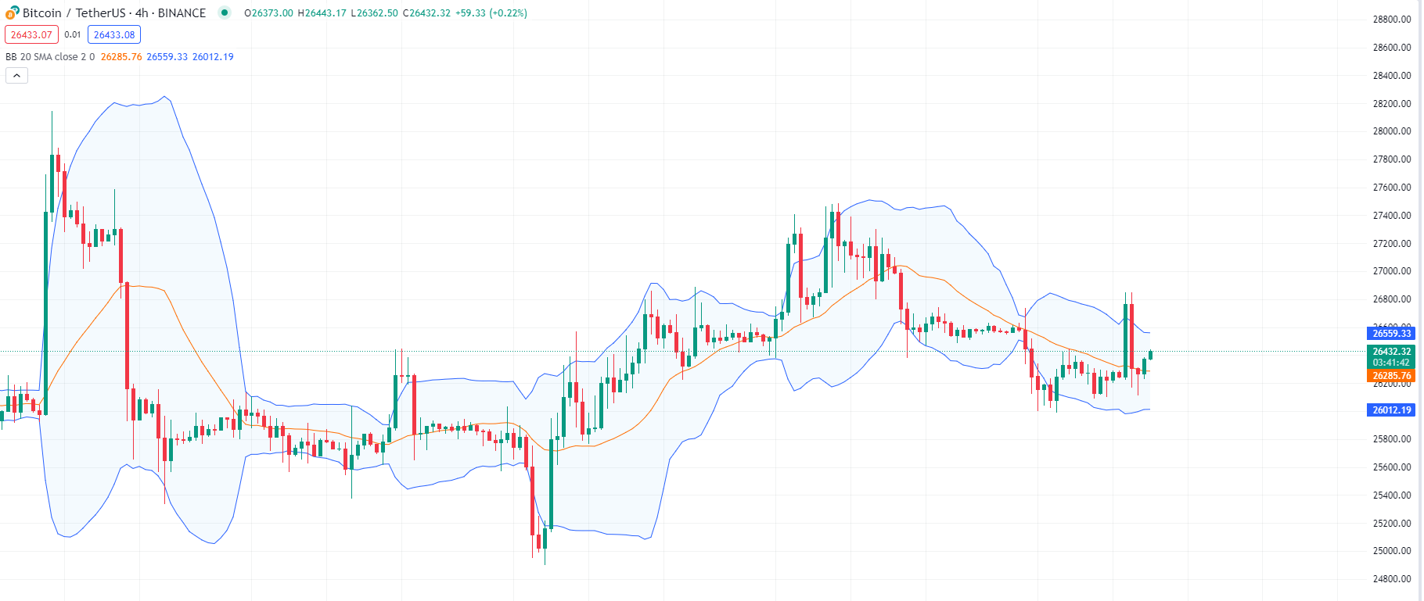
Bollinger Bands

Slide 9
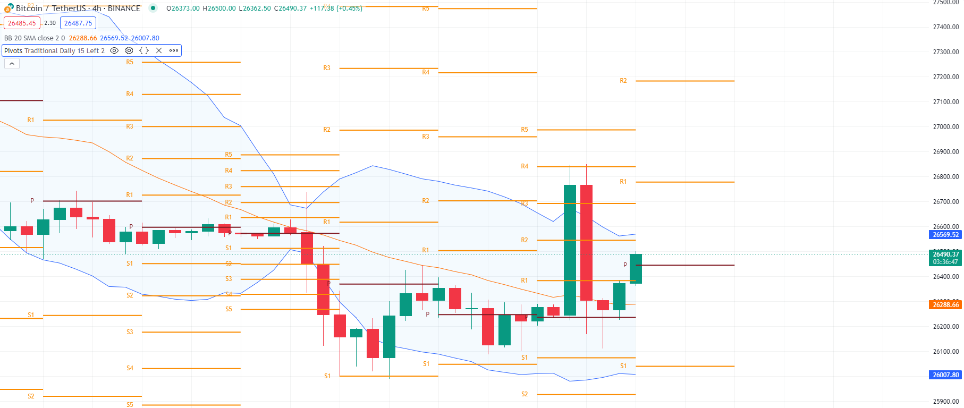
Bollinger Bands + PP (4h)

Slide 10
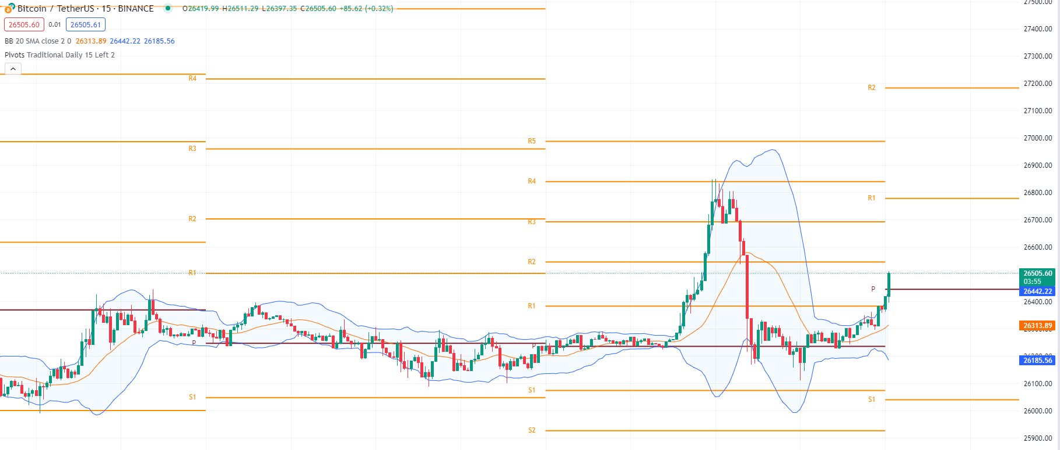
Bollinger Bands + PP (15M)

